Slide 1
Tips for this training
Please:
Mute yourself to enhance listening for all
Use the chat box to ask questions
Midway we will take a break for questions
There will be more time at the end for questions

Slide 2
Student Travel
By Heather, Alex & Rossitza
Notes:
Amanda will do welcome

Slide 3
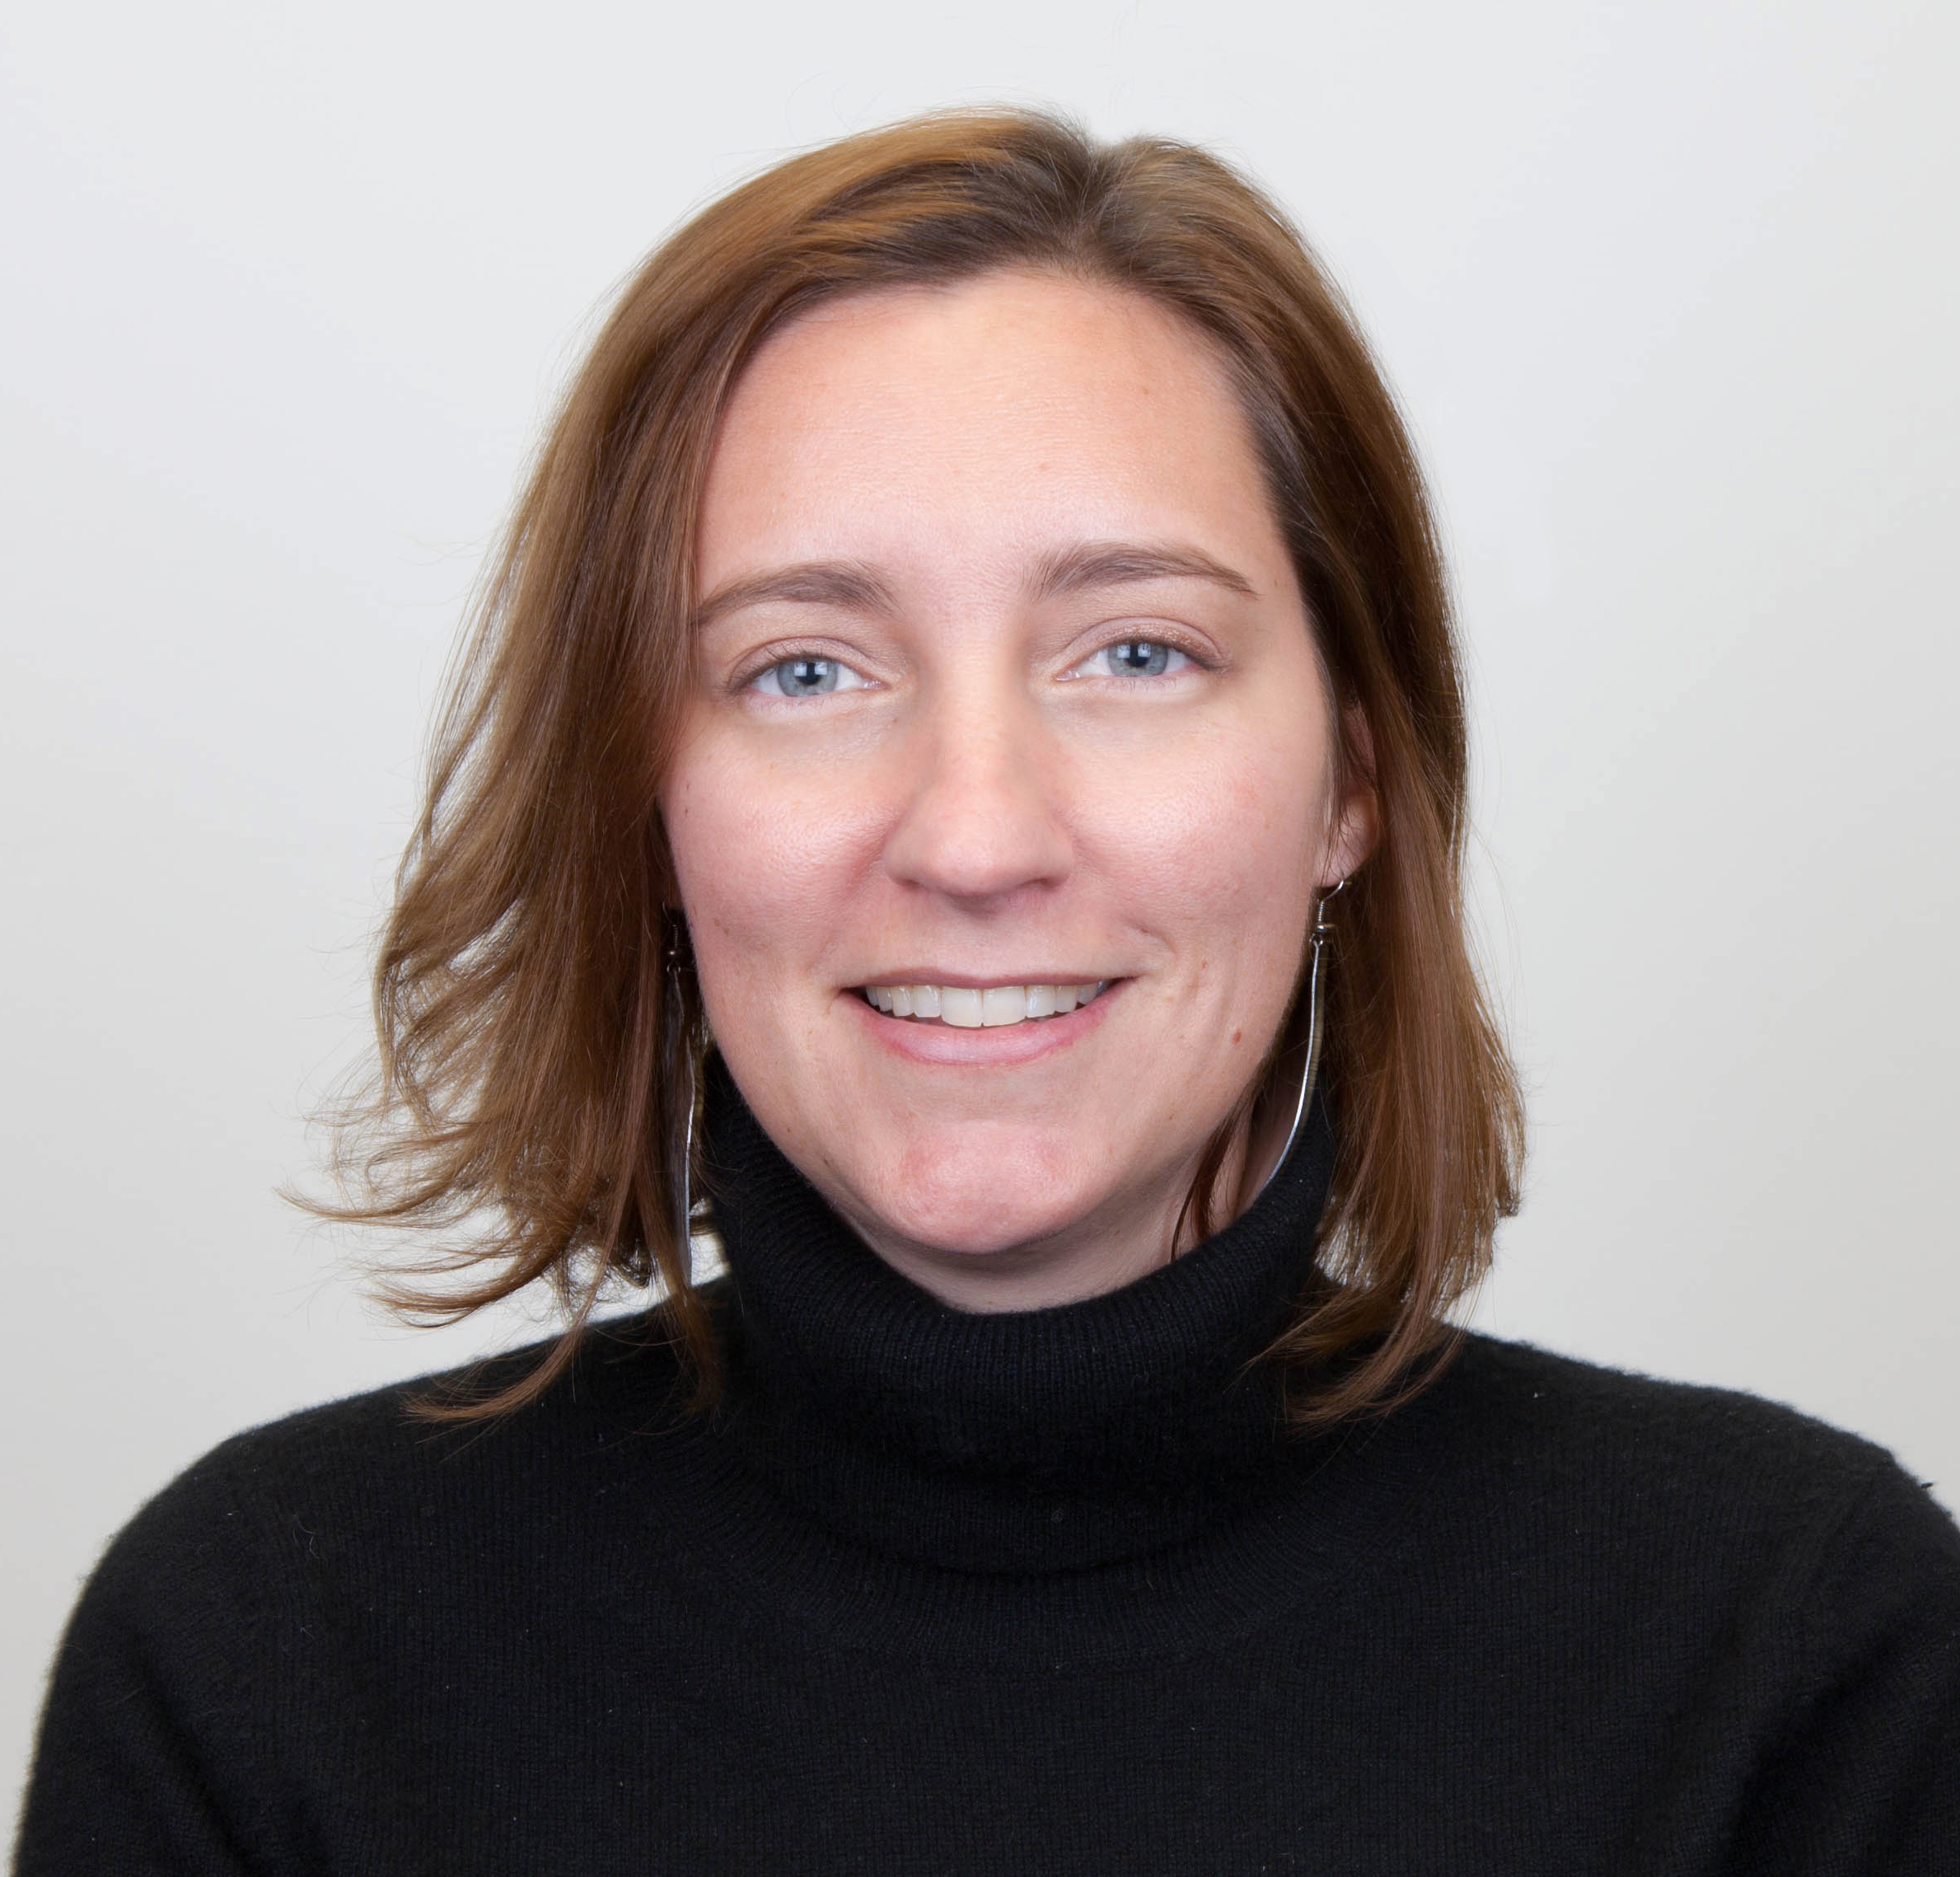
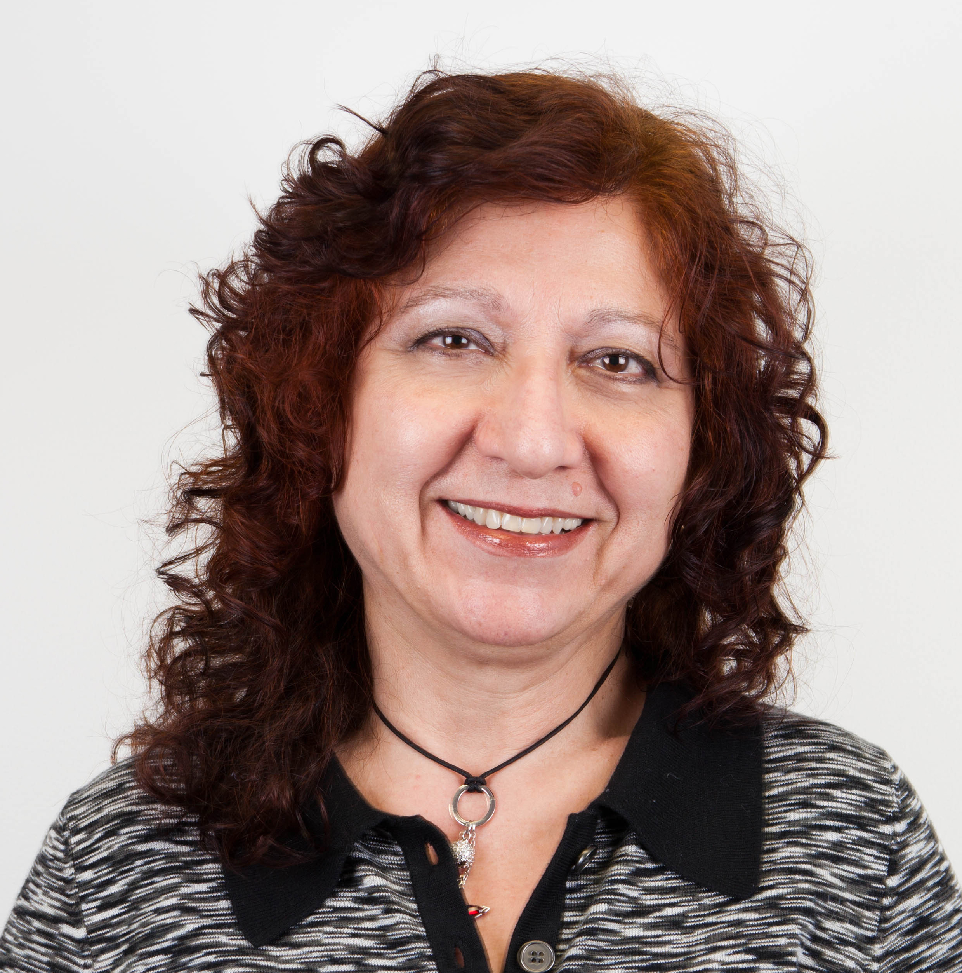
Facilitators
Heather Dorsey
Started at YFU in 1999 in AO
Helped create the new YFU USA Travel department starting in 2001
Rossitza Newhall
Has been at YFU since 2012 in both Travel & HR
Experience in Travel since 2004
Alex Lopez
Director of Travel since 2006
In the travel industry for 37 years
Passionate about coordinating cultural exchange
Notes:
Amanda will introduce Heather, Rossitza, & Alex
Heather Dorsey:
Has worked at YFU since 1999. Joined Travel in 2001, when YFU USA took over travel operations from an outside travel agency. Helped to create and define the new department and its procedures and to foster our relationship with Skylink.
Rossitza:
Alex Lopez:
Has worked at YFU since 2006 as Travel Director. In the travel industry for 37 years managing prestigious accounts and coordinating cultural and educational exchanges all over the world.

Slide 4
Objectives
Understand how YFU Group Travel works – its benefits & its limitations
Understand the Airport Assistance program, overnights and the HF notification system
Understand the importance of on time & accurate Airport Coding
Respond effectively to changes of departures and flight delays
Notes:
Amanda will present:
Objectives:
Describe the travel notification process and the “overnight” process in order to communicate effectively with families
Identify key dates and timelines of travel activities
Understand the importance of Airport
Respond effectively to changes of departures and flight delays

Slide 5
Group Travel
Can’t purchase individual flights…
WHY?
Students travel in groups because…
Safety Benefits
Financial Benefits
Contract group fare at lower cost
Service Benefits
Airport assistance
Notes:
Safety benefits
Safety - Students fly together and we can verify multiple arrivals at once
Financial benefits
Contracts – Airlines allow us to block seats well in advance at a lower cost
Efficiency - Booking students onto group flights is less time consuming and allows for a smaller staff than individual bookings would require
Service benefits
Control – We determine arrival & departure dates, times, connections & layovers
Assistance – YFU staff are able to meet all arriving and departing group flights and assist students with connections or flight irregularities
Communication – We can confirm arrivals & departures to partners en-masse, and to Host Families via the notification system (text, e-mail or voice mail)
Experience – Airport staff are familiar with their airports and rebooking policies
Efficiency – Airport staff can rebook multiple students at the same time and report back, rather than waiting for each student to contact us with new info
Security - We will arrange & chaperone overnights when students get stranded
Confidence & Peace of Mind –24/7 emergency hotline

Slide 6
Service Benefit
Airport Assistance… HOW IT WORKS
YFU
24 hour Emergency hotline 1-800-705-9510
5 Travel Assistance Coordinators in DC
120 airport staff at 11 hub airports
Airport Staff stay on-site until all students are accounted for
Notes:
Rossitza
24 hour emergency toll-free hot-line
Airport Assistance at 11 major U.S airports and in Frankfurt, Germany
120 Airport Staff members are present for all international arrivals and departures and all domestic connections through our 11 staffed airports:
Staffed airports are Atlanta, Chicago, Dallas, Denver, Detroit, Minneapolis, Newark, San Francisco, Seattle and Washington, DC (Dulles), LAX
5 temporary Travel Assistance Coordinators (TACs) in Washington assist all students, host families, natural parents, volunteers and field staff via the toll-free hotline. They also manage the staff in the airports, directing staff to students who call for assistance.
Our Airport Staff & TACs stay on site until all students are accounted for – either departed the USA on an international flight, at their final destination, or with staff at an airport hotel for a scheduled or unscheduled overnight

Slide 7
Over-night
Procedure:
Met by YFU Airport staff at arrival gate or baggage
Student & staff travel on hotel shuttle
Staff & student stay at hotel
Staff orders food
Next day staff helps student check-in at the airport
Notes:
SCHEDULED
Inbound - if a student cannot make it all the way to their host family’s airport before 11:30pm, we will stop them at a staffed airport in-route and overnight him or her
Outbound – if a student cannot make it to the international departure gateway airport in time for the international group flight departure we will fly him to the gateway the evening before and overnight him
UNSCHEDULED
If a student’s flight is cancelled due to any situation (weather, mechanical, crew, etc…) and the next available flight isn’t until the following morning, we will overnight him or her at a staffed airport (not if it is student’s origin airport).
PROCEDURE
Students are met by YFU Airport Staff at their arrival gate or baggage claim
Students and Airport Staff travel by free hotel shuttle to a corporate hotel near the airport where we have a business account.
If there are multiple students, they will share rooms (according to gender). Staff have their own rooms.
Students and Airport Staff check in and staff member orders food for everyone
Students and Airport Staff check out and take the shuttle back to the hotel the next morning in time to check-in connecting flights

Slide 8
INBOUND FLIGHTS
WHY Host Families can’t just pick a specific date:
Assigned on groups
School start date = priority assignment
YFU USA informs partners by June 5th which students will fly on X date
Request are considered
Email Heather at hdorsey@yfu.org before June 5th
Notes:
Partner countries who send 30 students or fewer will have one group flight date for all of their students.
Partner countries who send more than 30 students will have two or more group flight dates for their students.
Students from multiple flight date countries will be assigned to flight dates according to their placement date, school start date, or special request (If received early enough).
HFs can make requests if they will be out of town for some of the group flights, or if they want the student before or after a certain date.
Students and partners can make requests for a specific group flight because of school or Natural Family issues in home country
We will try to accommodate any requests for specific groups when possible, but school reasons are top priority
Send requests via e-mail to Heather as early as possible
Once dates are confirmed to partners (June 1) it is difficult to make changes

Slide 9
EXCEP-TIONS
EXCEP-TIONS
Approved
School
Illness
Death in family
Visa delay
Not approved exceptions:
Vacations
Sports
Band
Notes:
All inbound students are expected to fly with a group flight.
We will make exceptions to this rule and arrange travel in the following :
Students whose school start dates in the USA are before group travel date
Students who cannot travel on the group date because of school in their home country
Students who cannot travel on the group date because of illness
Students who cannot travel on the group date because of visa delay
Students who cannot travel on the group date due to a death in the family
Non-group travel to vacation with Host Family or for sports/band practice are NOT approved exceptions to travel on a group flight, and neither is early or late travel due to Natural Family vacation plans.
Students who insist on traveling separately from a group flight for vacation or non-academic or illness related reasons must arrange their own round trip travel and will not have YFU airport assistance. These are Independent Travelers.

Slide 10
Airport Coding
Travel’s responsibility:
-Provide airport code deadline chart by June 1
Field Staff Responsibility:
Provide HF airport codes into AS/400 by deadline
Airport is where HF lives or best guess
Changes in airports after ticket issued = $150-$300 fees
Notes:
Field Staff provide Travel with the Host Family’s arrival airport for each inbound International student so we know where to fly them.
While Airports are automatically uploaded as a student is placed, we often need airports before the students are actually placed, since we must issue tickets by a certain airline deadline.
Not meeting deadline means automatic cancelation of blocked seats, higher airfare inventory, and/or a $150-$300 penalty per seat plus airfare differential at the time of re-booking. All of these are avoidable if we have correct airports and few changes.
Travel sends District Directors the Airport Coding Deadline List in May or early June.
Field Staff need to enter the correct (or best guess) airports into the AS/400 by the deadline noted for each student’s group flight.
Airport coding on time is extremely important to keep our travel costs under control.

Slide 11
Airport Coding
Travel Changes:
AS/400 auto-generated airport changes as placements are entered
must be monitored in case they are not necessary
We rely on your information
Your Work impacts Travel:
Last minute changes
Require as much work after placement is complete
Affects our staffing in airports
More changes = more airline fees & penalties
Notes:
Once the airport coding deadline passes, we issue tickets. But sometimes the travel needs to be changed (HF cancellation, HF found in new location, HF request)
Each ticket change costs a re-issue fee of $150-300
Change requests are made by Field Staff in AS/400, and if a ticket is already issued it is a good idea to notify Heather directly by email
As placements are entered into the student system by Field and Registration Staff, the airport associated with that HF is auto-requested in the AS/400 & generates a report to Travel.
This is not always the correct airport, or a necessary change, and so this needs to be confirmed by whoever is entering placements (MKG vs. GRR, FNT vs. LAN, etc…)
This is an extremely important issue during August as airports are being updated just days before travel and we need to confirm if tickets must be reissued. Travel needs to know which tickets must be reissued without having to ask about every single update that comes though on the report.
We also need to alert partners of new itineraries and issue and send new tickets to partners in time for them to advise students and NPs before flight.

Slide 12
TRAVEL PROCESS
Airport Code given to Travel
Travel works with Travel Agency
Travel updates system
Travel mails itinerary to HF
Travel sends ticket to Partner countries
Before student Flies…
YFU Travel Staff
Notes:
Before students travel…
Field Staff advise Travel where to fly students via AS/400 airport coding.
Travel works with Skylink Travel Agency to book/change flights.
Travel updates itineraries in AS/400 (which eventually gets transferred to my.yfu.org) for all staff to access.
Travel sends itineraries and E-tickets to partners for distribution to students pre-flight.
Travel mails letter to HFs with their students’ itineraries, if there is time to mail it after the placement is entered.
Note: YFU travel Staff have to work around the clock – field staff can help by reducing last minute changes late in the evening
The travel process everything leading up to the travel day comes from “me” (Heather), then on the day of travel Rossitza’s team takes over. Something before travel, contact Heather. If something is happening on the day of travel, contact Rossitza.

Slide 13
Travel Process
Student Arrival Day….
Travel Agency monitors all departures from partner countries
YFU Airport staff meets arrivals
If problems, Airport staff…
Notifies NO of any problems
Helps students with rebooking, if necessary
Sends out notifications to HFs
*Encourage Host families to OPT into Travel Notification*
Notes:
Rossitza -
Students’ arrival day…
Skylink advises YFU Travel of any delays/cancellations from overseas origin point and of any re-bookings they have made.
YFU Airport staff advise Travel of any flight delays/cancellations/missing students at US staffed airports, and confirm new rebooking info to TACs.
TACs send out notifications to HFs via YFU Travel Notification System (HFs must opt –in to this service via HF account).
If HFs are not signed up for Travel Notification System, TACs contact on-call SSMs to help forward new flight info to HFs.
HFs should be following flight status themselves. Travel cannot notify HFs about every flight delay. We only forward NEW FLIGHT INFORMATION.
IMPORTANT TO NOTE- we do not send out notifications if the flight has been delayed. So host families should check on the status of the flight.

Slide 14
RETURN TRAVEL
January – April CDRs are accepted & completed for a fee
May-June
IS return tickets mailed out
June 15-30
IS return student groups depart
November
IS Return Request System is open
December
IS return flights assigned
January
Return date confirmation letter with CDR info mailed to all IS & HFs
Can students choose their return date?
Notes:
Return Travel
All year program students’ group flights return between June 15 and 30.
We start blocking and booking return travel in the fall after students arrive.
There is a designated period of about 3 weeks in November when students (with the help of their HFs) can login to their HF account and see the return date for their country. If they come from a country that has multiple dates, they can choose their preferred of these dates. Once the request deadline is passed, we assign all students to return groups, honoring as many requests as possible. Students are assigned to return flight dates according to school tern end date and the date they arrived into the USA.
In January, we send letters confirming each student’s return date. This letter also instructs students on the CDR (Change of Date Request) process. Students can change their return dates to stay longer in the USA or return home early if necessary if all parties agree (HF, NPs, partner). There is a fee to change the return date, and students who do not return on a group will not have assistance in the airports.
Return tickets are issued and mailed to students on a rolling chronological basis in May-early June.

Slide 15
Contact Info
TRAVEL HOTLINE:
1-800-705-9510 for all Travel related questions
Alex Lopez, Director of Travel alopez@yfu.org Phone:202-774-5255
Heather Dorsey, Manager of Travel Operations hdorsey@yfu.org
Phone: 202-774-5251
Rossitza Newhall, Travel Operations & Systems Specialist rnewhall@yfu.org Phone: 202-774-5254

