Slide 1
What is YFU? Our Mission
YFU advances intercultural understanding, mutual respect and social responsibility through educational exchanges for youth, families and communities.

Slide 2
Our Values
Learning: For Life.
Volunteering: Engaged and Dedicated.
Caring: Personal and
People-Oriented.
Valuing Diversity: Inclusive and Fair.
Promoting Quality, Transparency, Sustainability.
Cooperating in International Solidarity.

Slide 3
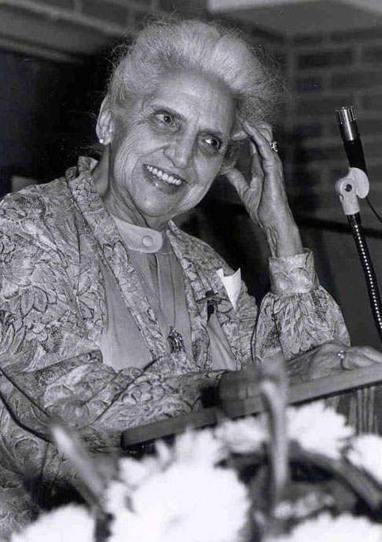
The History of YFU
It all started in 1951
Founded by Dr. Rachel Andresen
Small group of students from war ravaged Germany
Living and studying together to Build Bridges of Understanding
Still resonates today – worldwide

Slide 4
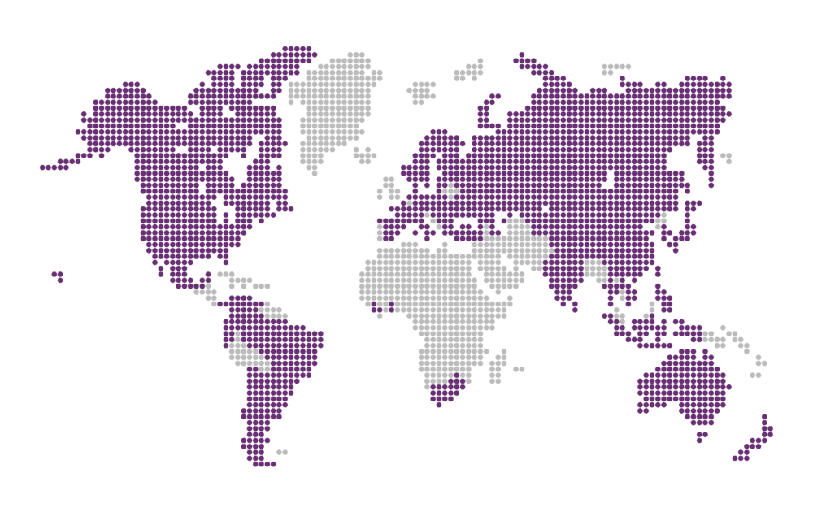
What is YFU all about today?
We’re Study Abroad with 70 YFU partner countries
Yearlong
Semesters
Summers
Short Term Excursions

Slide 5
YFU New Exchange Experiences
Teacher-Led Excursions
Virtual Exchange
Adult Study Tours
Gap Year Programs

Slide 6
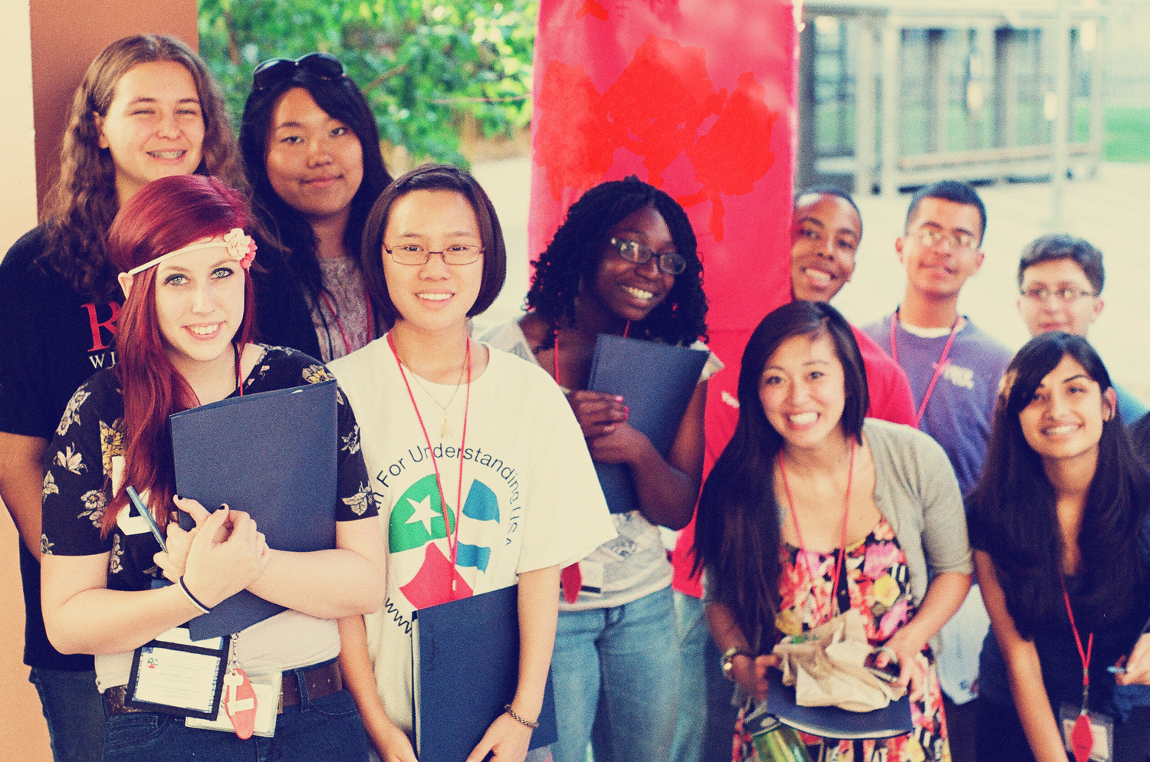
Making Scholarships Possible
Facilitating more corporate and government scholarships
than any other exchange organization in the nation

Slide 7
The YFU Hosting Experience
Fantastic students from around the globe think your
ordinary family is extraordinary

Slide 8
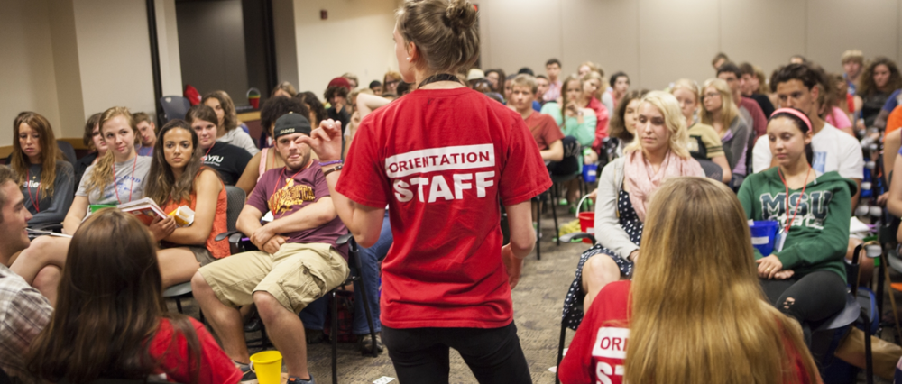
So Many Ways to Volunteer!
1,500 dedicated volunteers nationwide

Slide 9
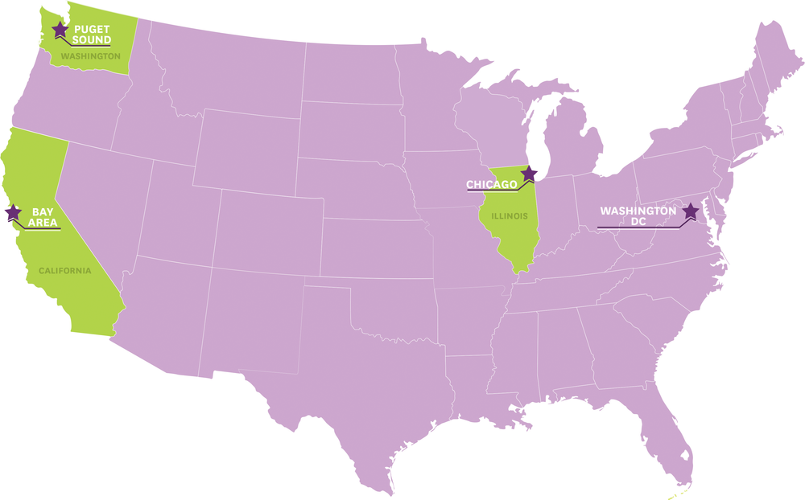
260,000 Worldwide Alumni
Connecting
Sharing
Networking
4 YFU Alumni Chapters

Slide 10
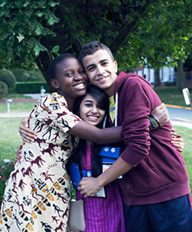
YFU is a part of your community, your churches, your schools, and most importantly your homes and your hearts!

Slide 11
Youth For Understanding Making the World Our Home JOIN US!
Study Abroad | Host a Student | Volunteer
www.yfuusa.org 1.800.TEENAGE

